Slide 1

Predicting Customer Satisfaction for a US Airline
Fushu Beauthier, Rachel Liu, Emma Tuhabonye
Data source: https://www.kaggle.com/johndddddd/customer-satisfaction

Slide 2

Airline Satisfaction for a U.S. Airline: The Problem
After their flight, passengers have given a US airline their customer feedback, via a survey asking them to rate the quality of various services, along with their overall satisfaction ratings (satisfied vs. neutral/dissatisfied)
The problem we are interested in is finding out whether we can accurately predict future passengers’ overall satisfaction ratings for this airline, based on different combinations of ratings for the various services related to the whole flight experience.

Slide 3
Description of the Data
The data was collected from a US Airline passenger satisfaction survey, and it measured key factors such as age, gender, class, customer type, flight distance, rating of different services, and minutes delayed.
Continuous/numerical variables:
- Age: Mean = 39.43, max = 85, and min = 7
- Flight distance: Mean = 1981.01 mi, max = 6951 mi, and min = 50 mi.
- Departure Delay in Minutes: Mean = 14.64 mins,
max = 1592 mins, and min = 0 mins.
- Arrival Delay in Minutes: Mean = 15.09 mins, max = 1584 mins, and min = 0 mins.
0-5 Ratings:
In-flight Wi-fi service: Satisfaction level of the in-flight wi-fi service (0=Not Applicable; 1-5)
Ease of Online booking: Satisfaction level of online booking (mean = 3.47)
Online boarding/check-in: Satisfaction level of online boarding (mean = 3.35)
Food and drink: Satisfaction level of refreshments (mean = 2.85)
Seat comfort: Satisfaction level of seat comfort (mean = 2.84)
On-board service: Satisfaction level of on-board service (mean = 3.47)
Leg room service: Satisfaction level of leg room service (mean = 3.49)
Cleanliness: Satisfaction level of cleanliness (mean = 3.71)
Check-in service: Satisfaction level of check-in service (mean = 3.34)
Categorical variables:
Gender: Female or Male, 65703 females and 63784 males.
“Type” of Travel: Purpose of the flight of the passengers (e.g. Personal Travel, Business Travel)
Class: Travel class in the plane of the passengers (Business, Eco, Eco Plus)
Customer Type: The customer type (Loyal customer, Disloyal customer)

Slide 4
Major Model: Random Forest
Model | Accuracy | Sensitivity | Specificity | Positive Predictive Value | Negative Predictive Value
Random Forest | .9318 | 0.9374 | .9249 | 0.9379 | 0.9244
Selection of
Primary Tuning Parameters
Cross Validated (15 fold)
Mtry held a constant value of 4

Slide 5
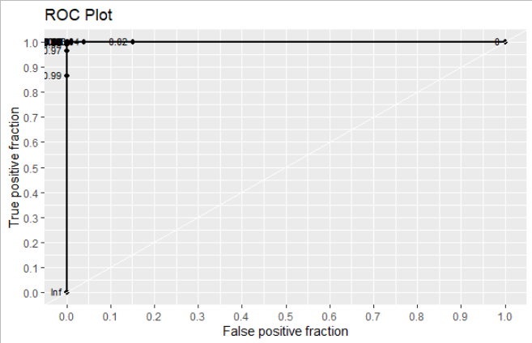
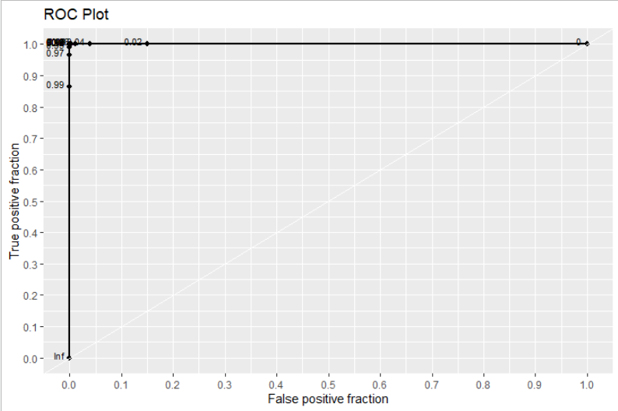
Receiver Operating Characteristic (ROC)
AUC = 1
Could be overfitting of training

Slide 6
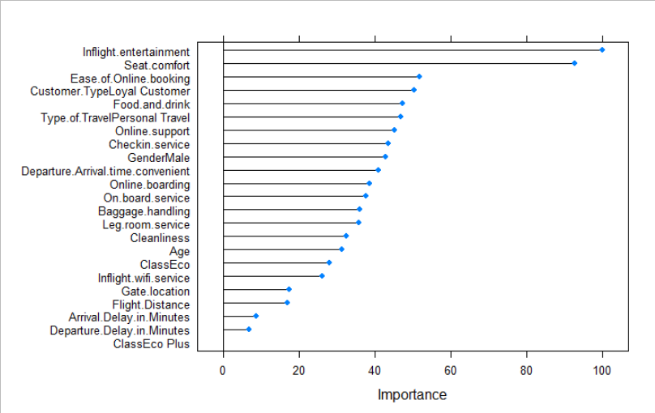
Variable Importance of The Major Classification Models

Slide 7
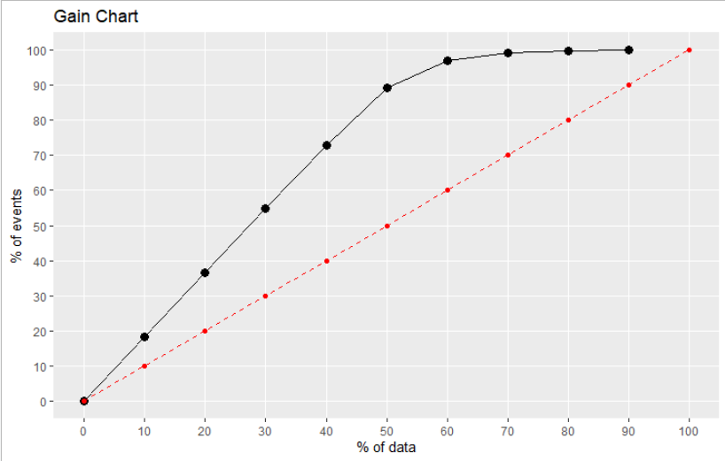
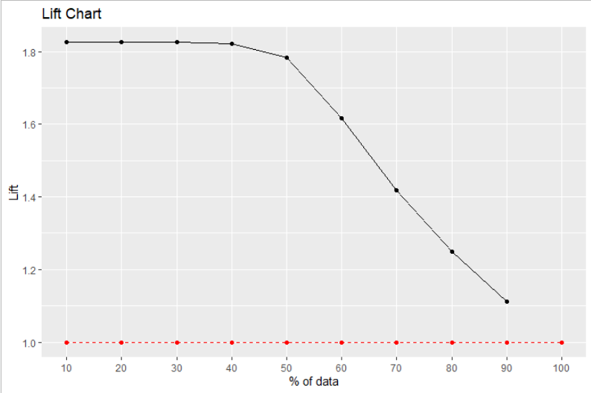
Gain and Lift Charts

Slide 8
Confusion Matrices: Performance Evaluation of Other Classification Models
Model | Accuracy | Sensitivity | Specificity | Positive Predictive Value | Negative Predictive Value
K-Nearest Neighbors | 0.8924 | 0.8754 | 0.9130 | 0.9240 | 0.8583
Classification Trees | 0.8867 | 0.9064 | 0.8629 | 0.8888 | 0.8840
Extreme Gradient Boost | 0.9372 ✓ | 0.9323 ✓ | 0.9412 ✓ | 0.9291 | 0.9439
Artificial Neural Network | 0.9217 | 0.9219 | 0.9215 | 0.9342 ✓ | 0.9861 ✓
Selection of
Primary Tuning Parameters
The final value used for the model was k = 6.
The final value used for the model was cp = 0.002437241.
max_depth = 3, eta = 0.4, and colsample_bytree = 0.6.
The final values used were size = 9 and decay = 0.01.

Slide 9
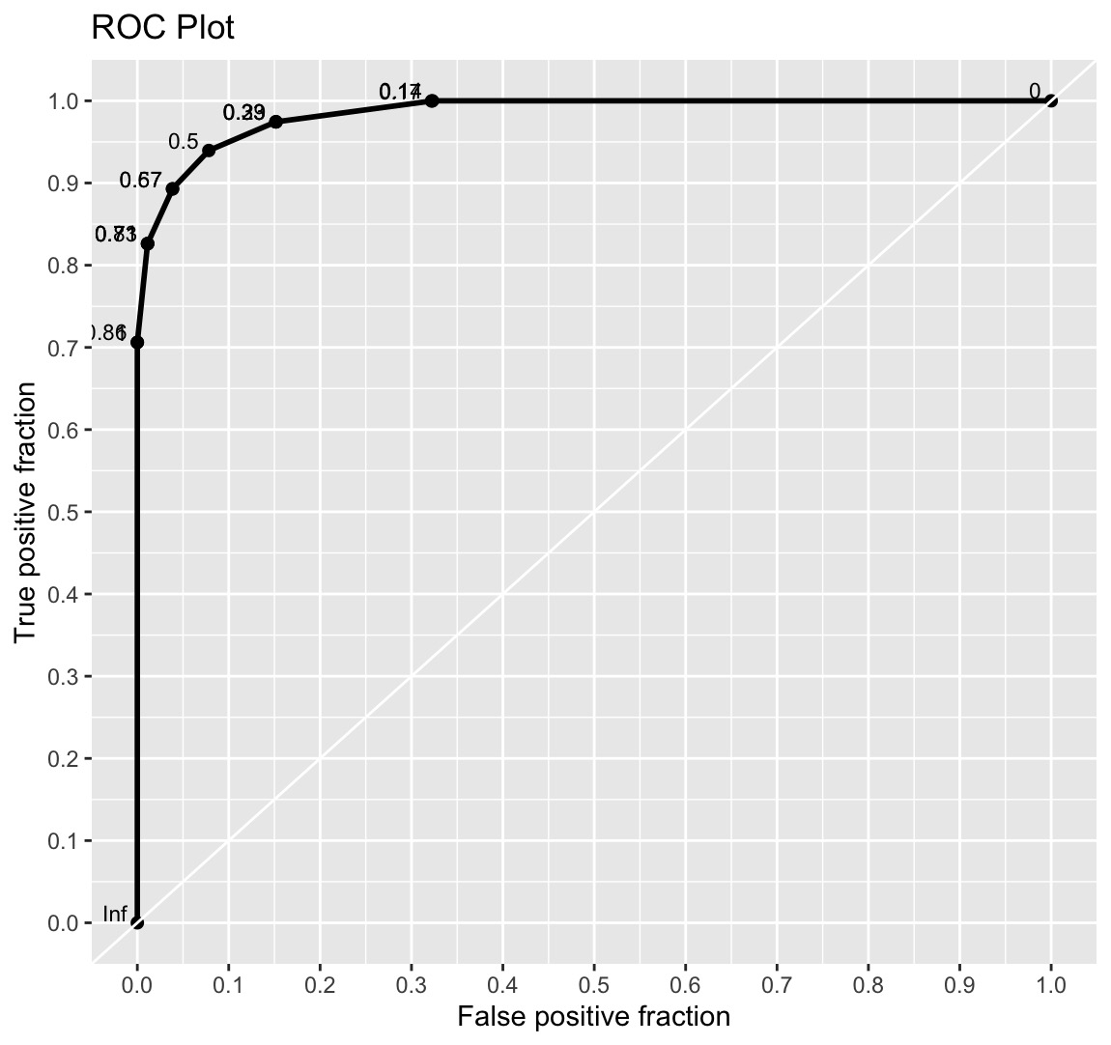
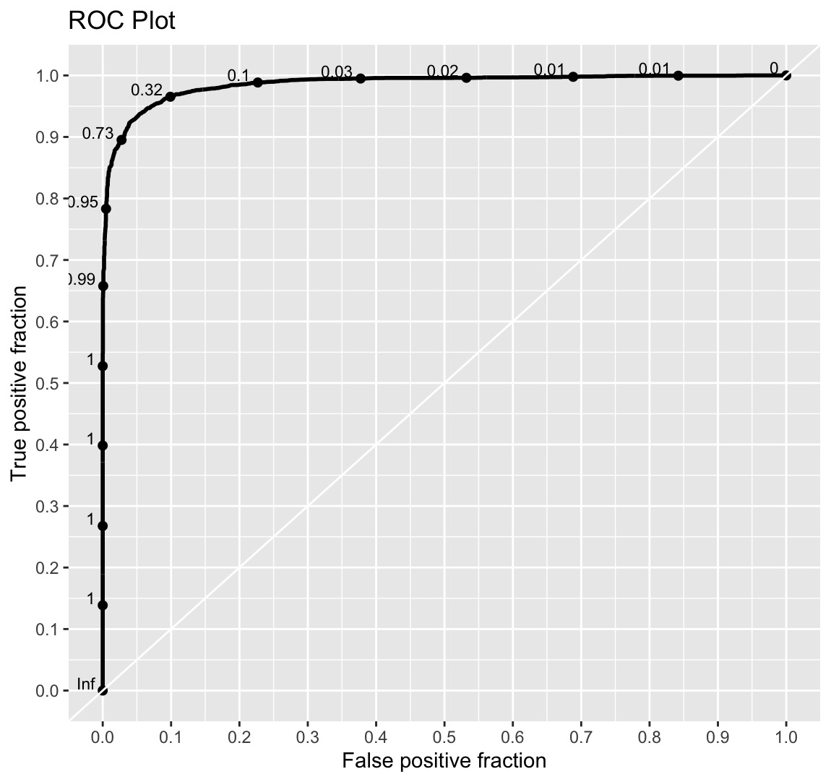

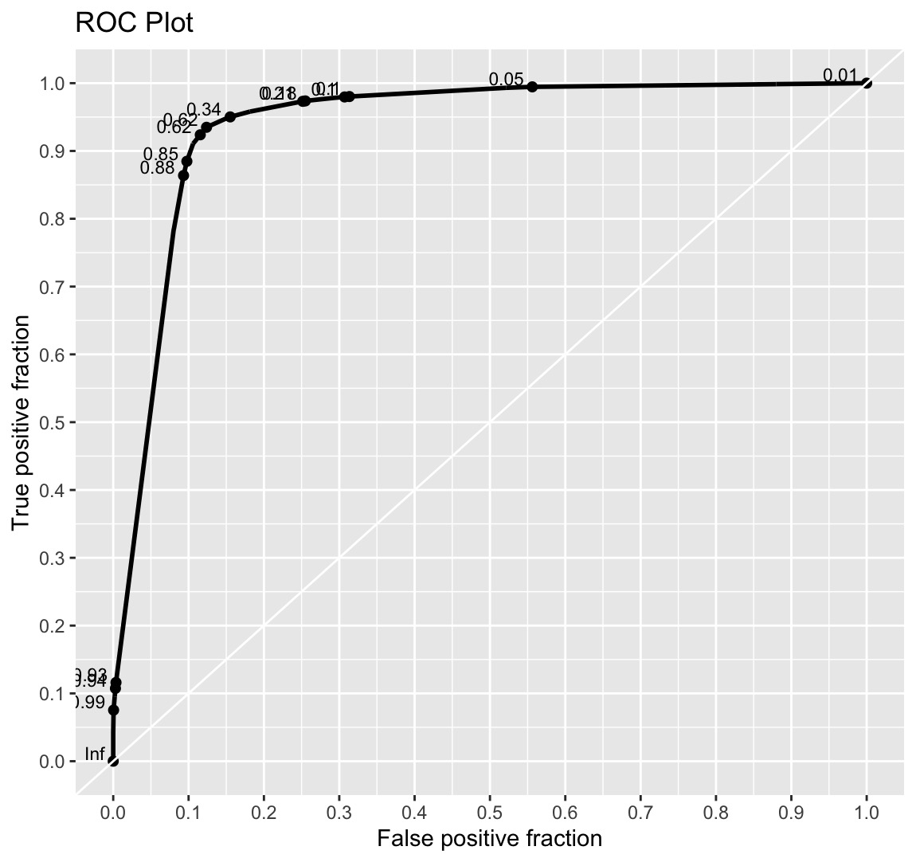
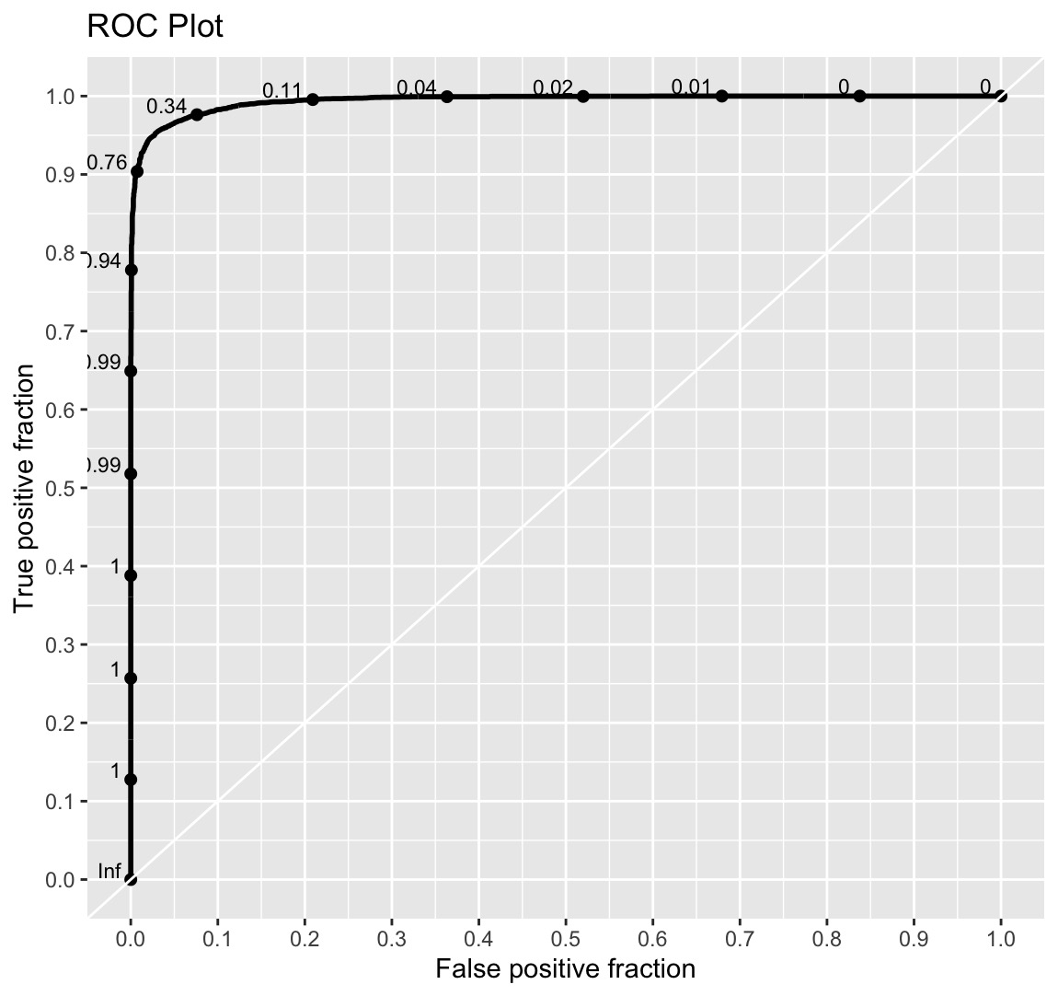
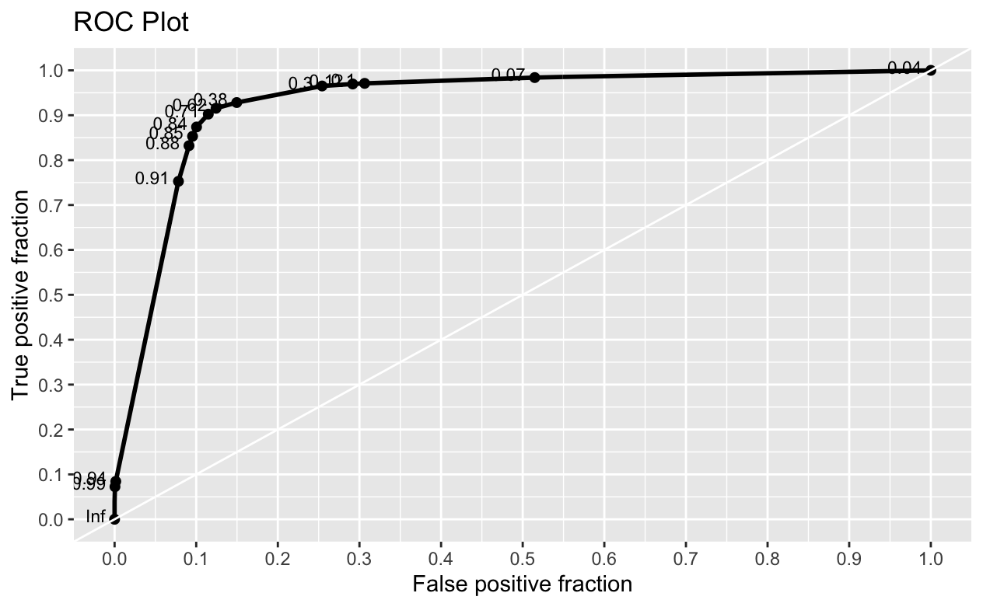
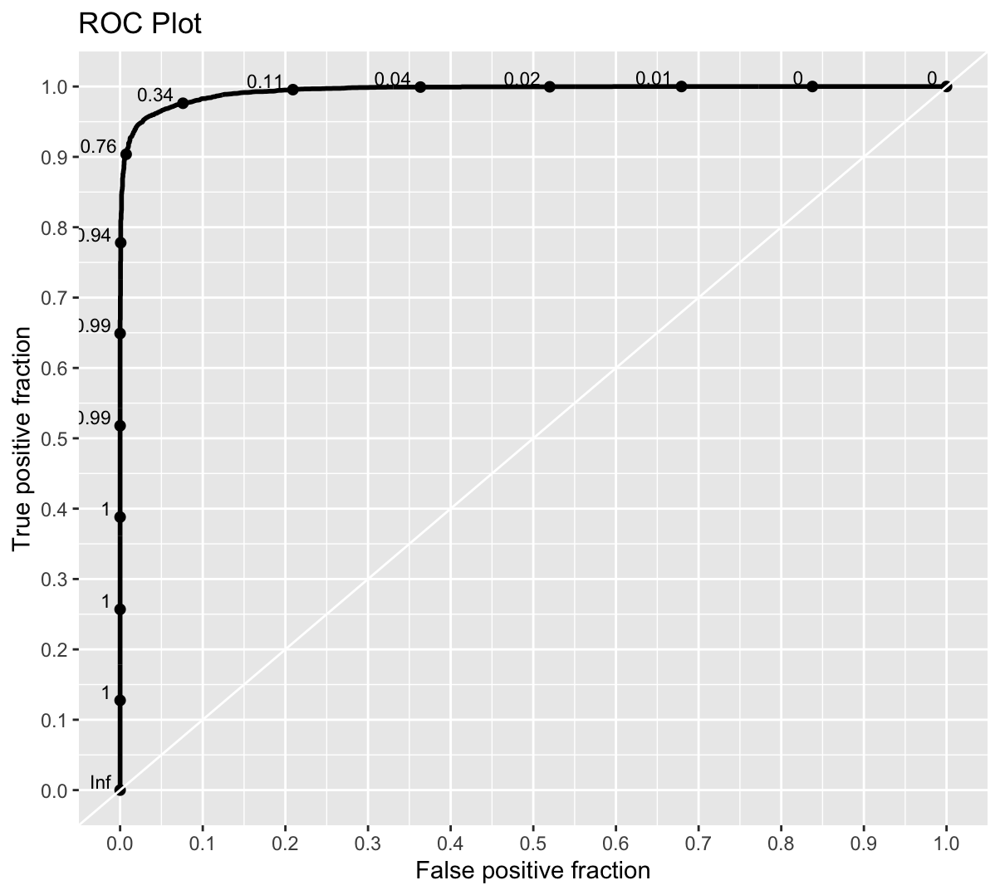
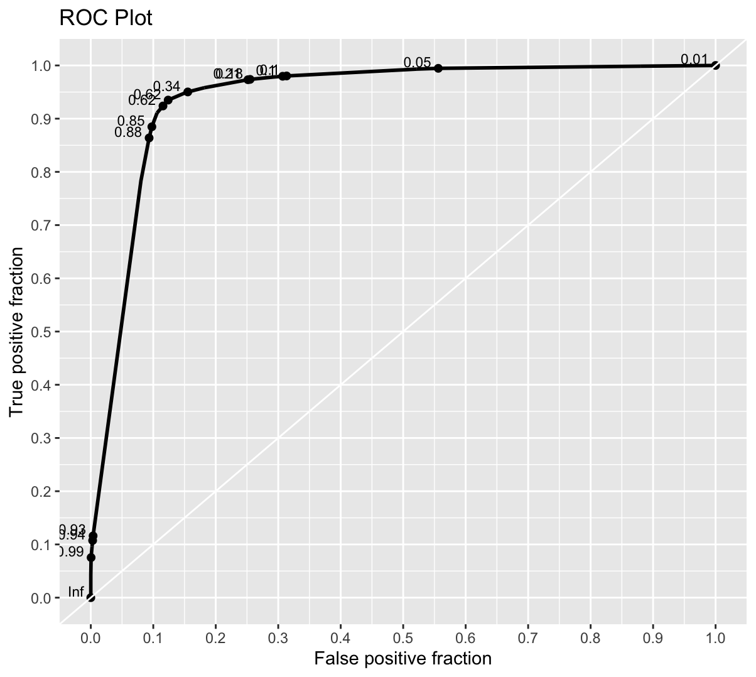
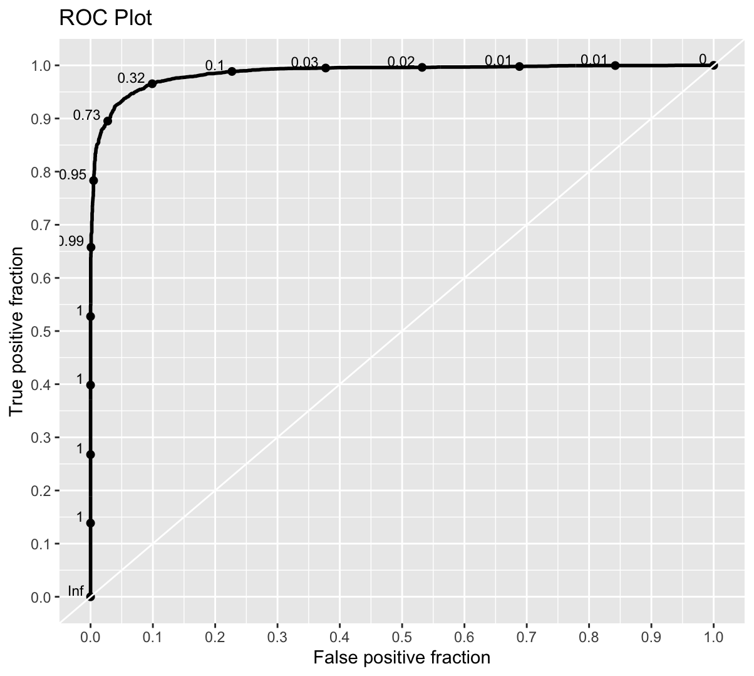
ROC of Each Classification Model On Training Data
K-Nearest Neighbors
Area under the curve: 0.9849
Classification Trees
Area under the curve: 0.9372
Extreme Gradient Boost
Area under the curve: 0.994
Artificial Neural Network
Area under the curve: 0.9861

Slide 10
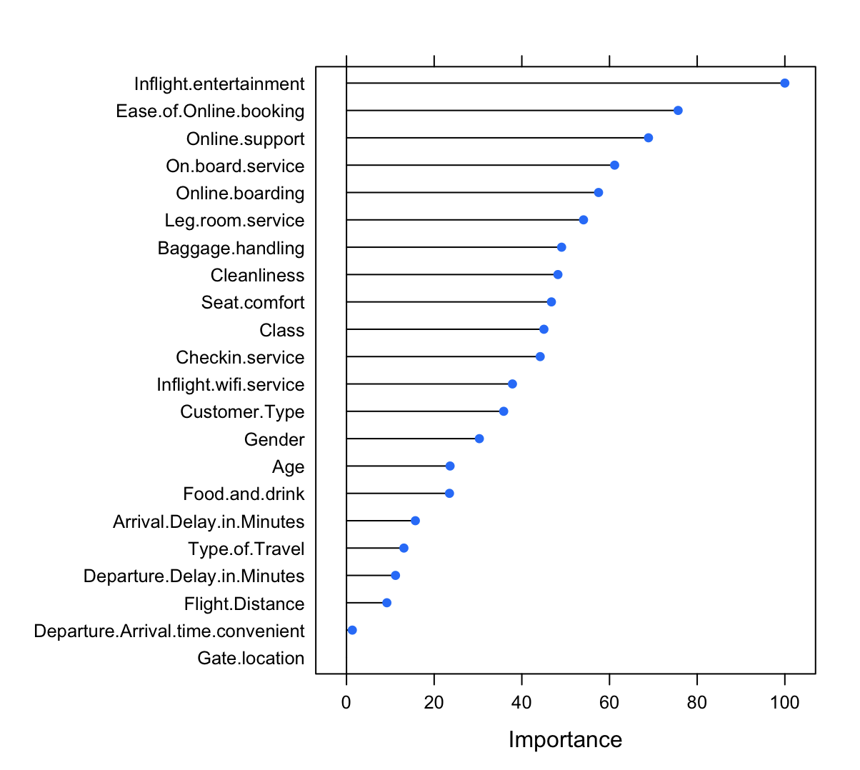
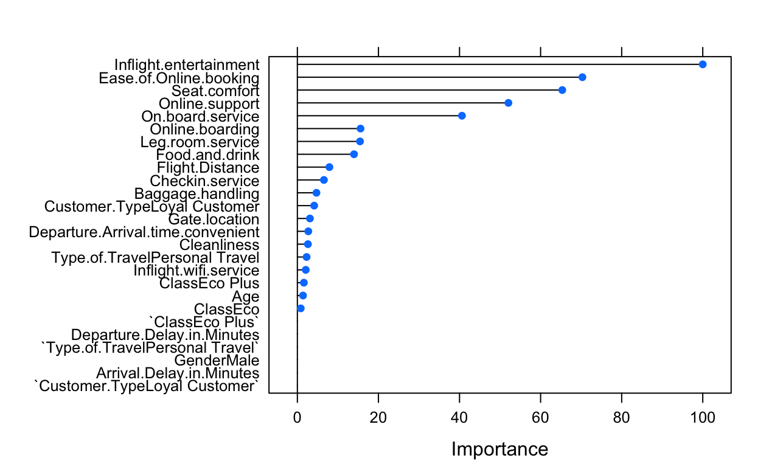
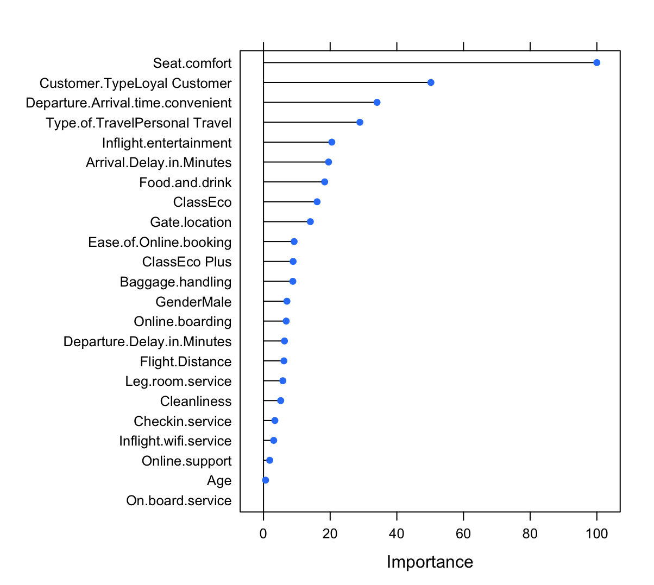
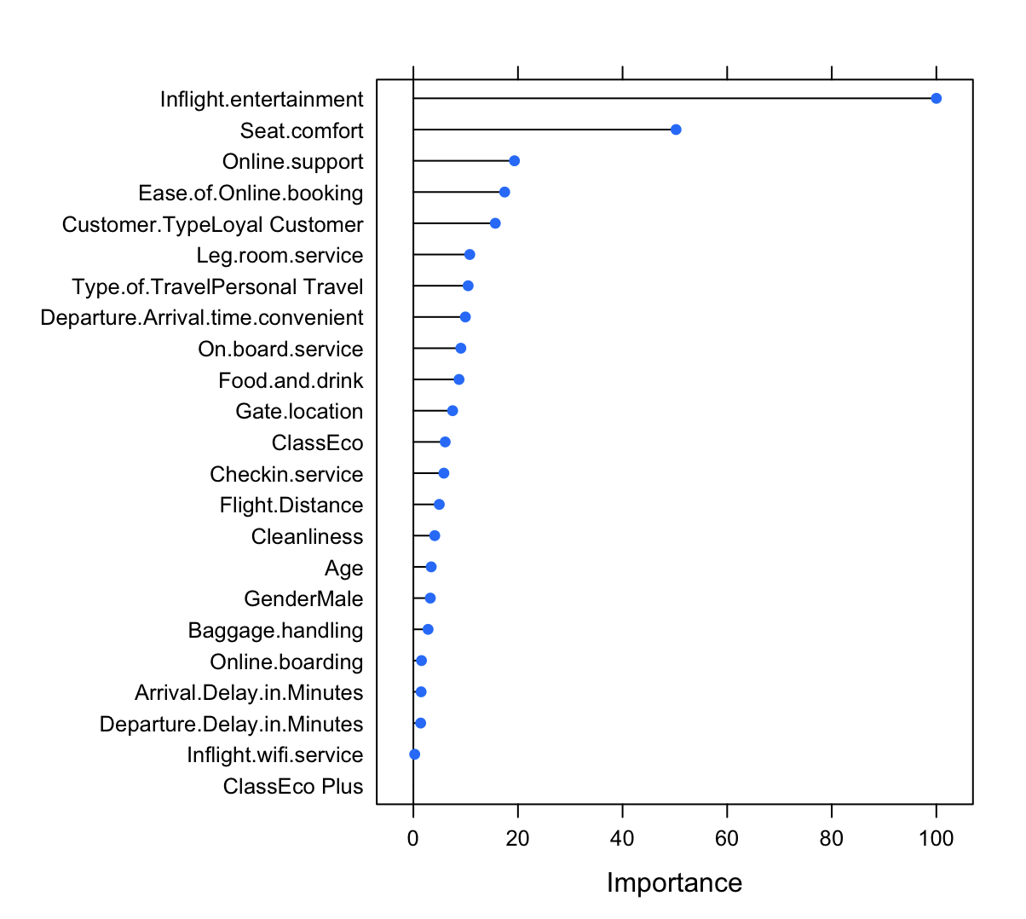
Variable Importance of Each Classification Models
K-Nearest Neighbors
Top Three Variables:
Inflight Entertainment
Ease of Online Booking
Online Support
Classification Trees
Top Three Variables:
Inflight Entertainment
Ease of Online Booking
Seat Comfort
Extreme Gradient Boost
Top Three Variables:
Inflight Entertainment
Seat Comfort
Online Support
Artificial Neural Network
Top Three Variables:
Seat Comfort
Customer Type (Loyal)
Departure Arrival Time Convenient
Important Factors: Seat Comfort (3), Inflight Entertainment (3), Online Support (2), Ease of Online Booking (2)

Slide 11
Implications & Limitations
Some of the most important variables for predicting overall customer satisfaction included: Seat comfort, in-flight entertainment If survey feedback is published (e.g., on the airline website), future passengers could quickly look at these few variables to predict whether they will be satisfied with the airline or not.
The airline should consider focusing on maintaining a high level of seat comfort and keeping up to date with the latest entertainment products to keep high overall satisfaction ratings!
We thought the survey was missing some other relevant factors, which could also affect passengers’ overall satisfaction with the airline. For example: 1) Covid-19 travel guidelines >> including a satisfaction rating measuring how safe passengers felt travelling with the airline/whether they were happy with how the airline dealt with the travel guidelines would be relevant
Improvements for the future: study correlation/collinearity between variables further

